Slide 1
Project: New consulting service at Kickstarter
Ohoud Rehbini
Project Overview :
Kickstarter is crowdfunding platform which can raise a small financial aid from large number of people throughout the internet. This platform is thinking to create a consulting service to project founder to help its customers create more successful crowdfunding campaigns.
It is important to clean up the data first for avoiding the duplicates and empty data. moreover, filtering the whole data in xls file showed that most of the funding date between 2010 to 2012.
4 Business questions to ask with Kickstarter data:
1. what is the best length of time to run a successful Kickstarter campaign ?
2. what is the ideal pledge goal ?
3. what type of projects would be most successful and getting funded ?
4. Is there an ideal month/day/time to launch a campaign?

Slide 2
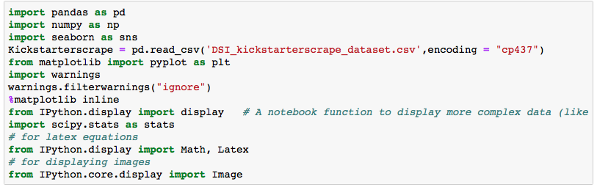
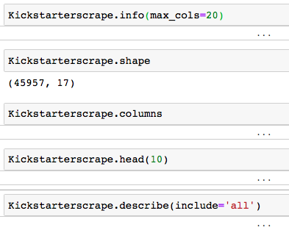
Methods, data reviews and cleaning process
Methods:
  Used Python method and import data using pandas
  All figures and number was imported using seaborn, numpy, matplotlib
  All the statistical analysis was imported using Ipython , scipy.stats
2. Data reviews:
  Checked by importing the information about the number of data , the number columns , and describe the data of each column.

Slide 3
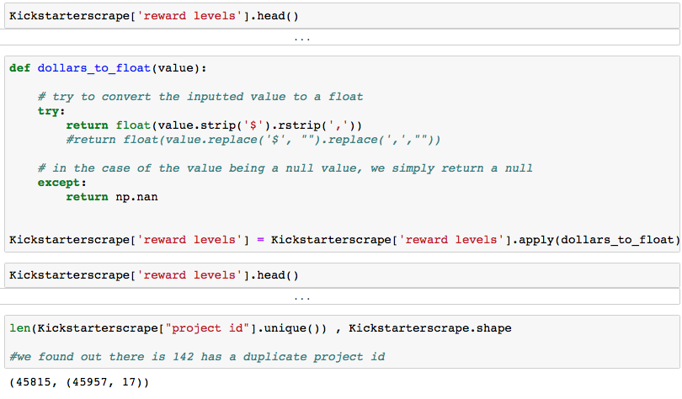
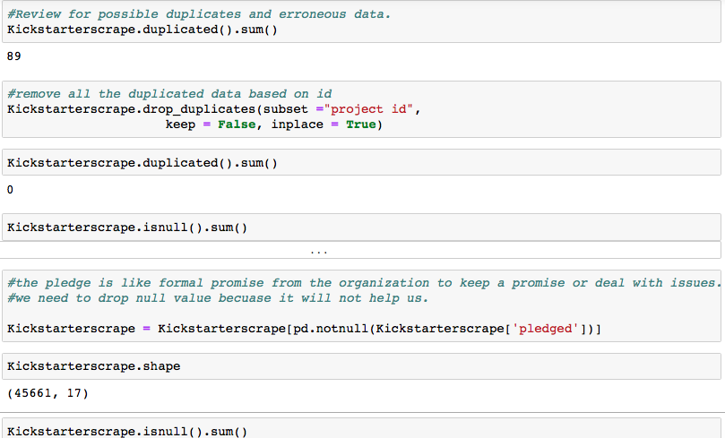
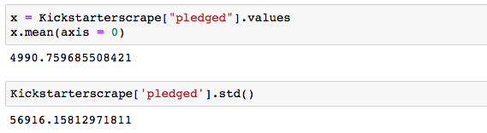
Cleaning the data:
  From 0, empty, $ sign can affect the results.
  Check the data uniqueness .
  Remove the duplicate data
  Remove some columns that has no major effect
The mean of total pledge that projects get :
This information can be obtained from describe data.

Slide 4
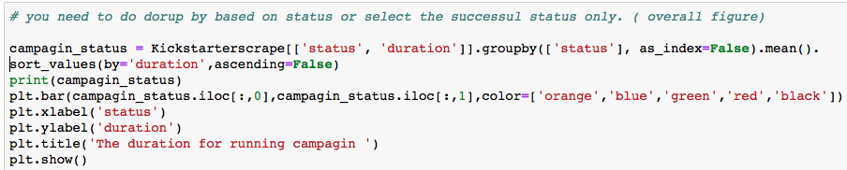
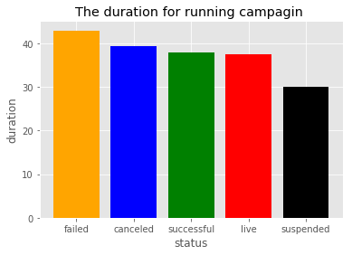
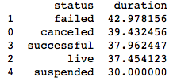
The best length of time to run a successful campaign
To run a successful campaign:
- select the successful campaign only by drop or remove the other status.
- then see the successful status based on pledged.

Slide 5
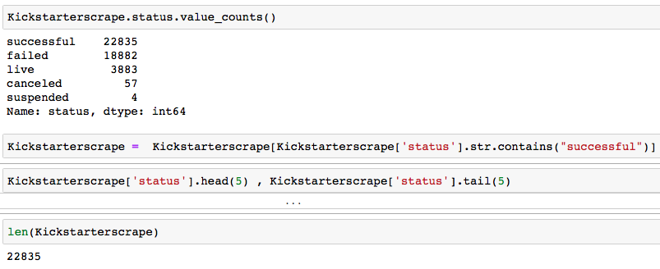
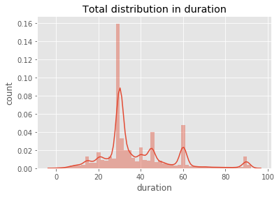
All the database is sorted for only successful
Campaign
The distribution of duration
Mean = 37.96
Mode=30
Median = 31.0
Std = 16.64
Area probability = 0.9887 > 0.05
Not normally distributed

Slide 6
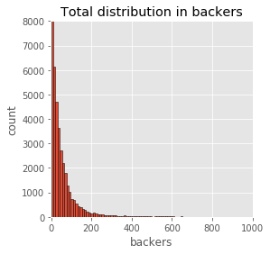
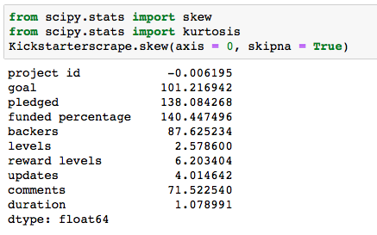
The backers

Slide 7
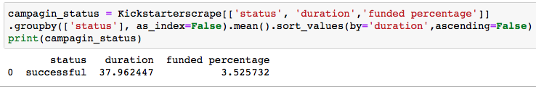
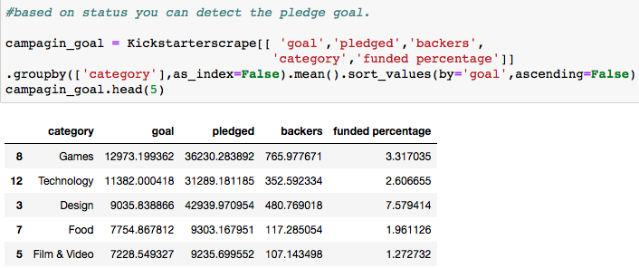
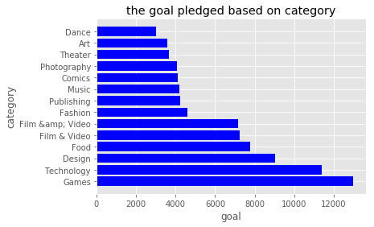
The best length of time to run a successful campaign
The duration of successful campaign :
The ideal pledge goal
In conclusion: Games and technology showed to be more funded promised and high backers followed by design and food.

Slide 8
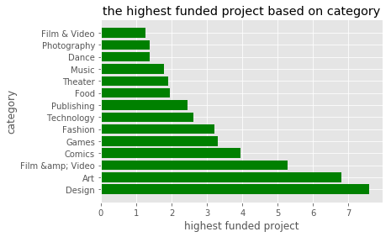
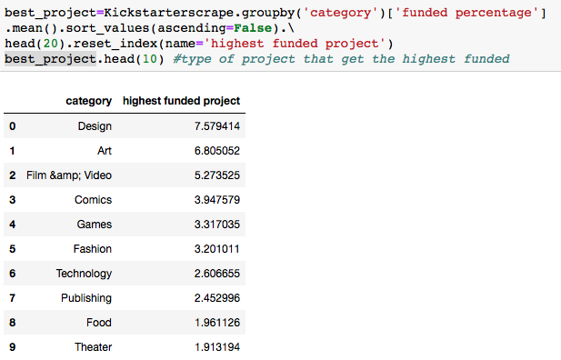
The type of projects which can obtain the fund
In conclusion: Design and Art found to have the highest funded percentage 7.5 and 6.8 each.

Slide 9
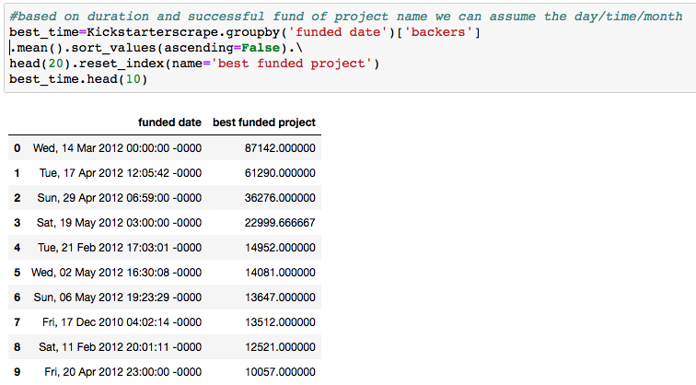
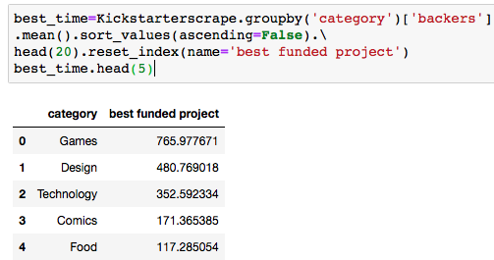
The ideal month/day/time to launch a successful campaign
In conclusion: based on the high project sponsor that best time was Wednesday on 14 march 2012.
In summary : Games, design and technology showed to be more funded promised, and more sponsored. The best time showed that 14 March 2012 obtained more funded project.

